Slide 1
Building Systems & Applications: Software Development, Programming, & Languages
10
Chapter

Slide 2

Chapter Topics
UNIT 10: Systems Development & Programming
10.1 Systems Development & the Life Cycle of a Software Project
10.2 Programming: Traditionally a Five-Step Procedure

Slide 3
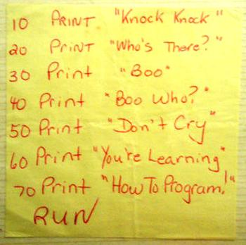
UNIT 10A: Systems Development & Programming
Learning to tell a computer what to do—that is, learning systems development and programming, the subject of this chapter—can be a great career booster.
You can do some computer-related projects yourself—including apps.
You can become a better communicator.

Slide 4
10.1 Systems Development & the Life Cycle of a Software Project

Slide 5

Purpose of a System
A system is a collection of related components that interact to perform a task in order to accomplish a goal.
A computer-based system consists of hardware, software, people, procedures, and data, as well as communications setups.

Slide 6

How It Starts, Who’s Involved
Users: The new system must ALWAYS be developed in consultation with the people who will be using the completed system
Management: Managers within an organization should be consulted about the system, because they control the budget and resources
Technical staff: The Information Systems or IT staff must be involved, because they will have to execute the project or work with the people who do
Systems Analyst: Information specialist who performs systems analysis, design, and implementation

Slide 7
Six Phases of Systems Analysis and Design
Systems analysis and design is a six-phase problem-solving procedure for examining an information systems and improving it.
The systems development life cycle (SDLC) is the particular step-by-step process followed during systems analysis and design.

Slide 8
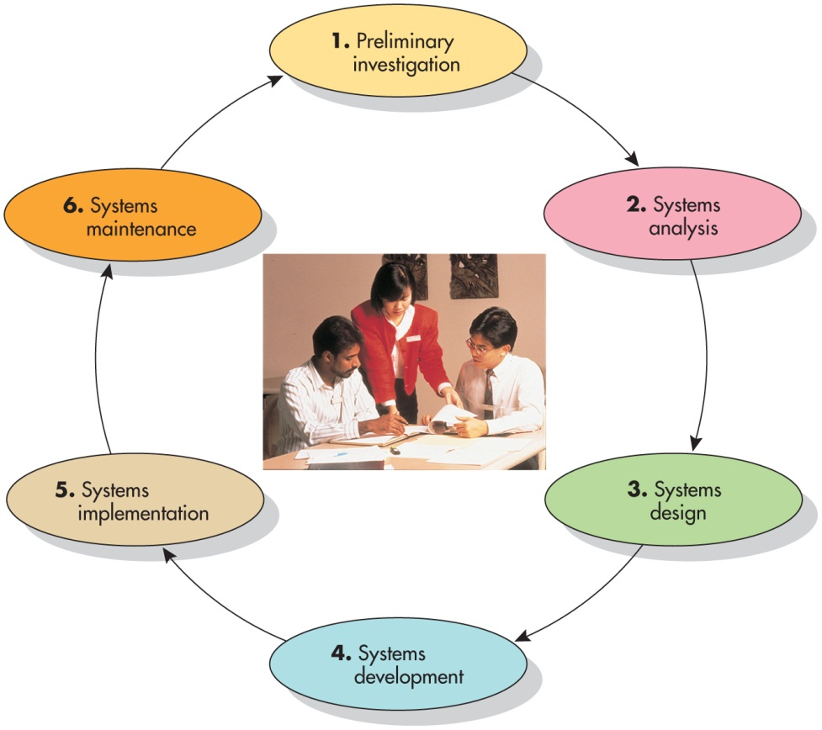
Systems Development Life Cycle:
Preliminary investigation
Systems analysis
Systems design
Systems development
Systems implementation
Systems maintenance
Information systems are frequently revised and upgrade
Steps in the cycle often overlap

Slide 9
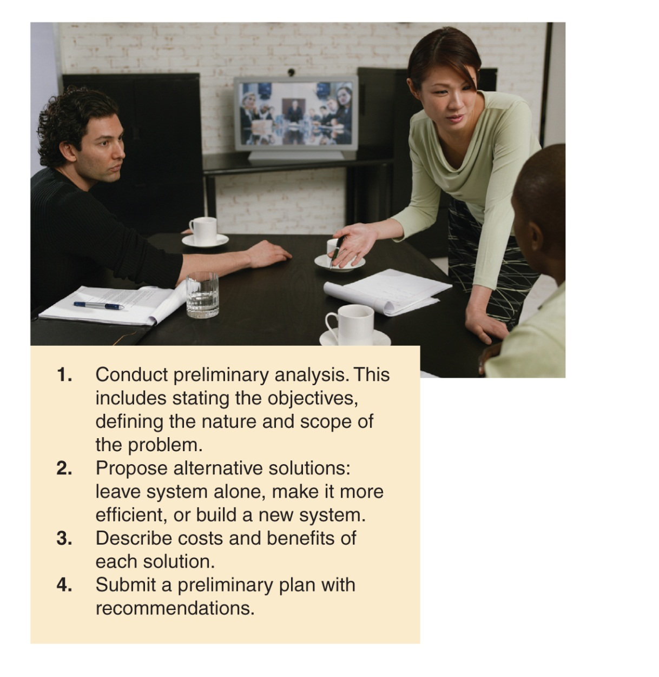
SDLC Phase 1: Conduct a Preliminary Investigation
Conduct a preliminary analysis
Propose alternative solutions
Interview people within the organization
Study what competitors are doing
Decide to leave the system as is, improve it, or develop a new system
Describe costs and benefits
Submit a preliminary plan with recommendations
This should be a written report
Get management approvals for next phase

Slide 10
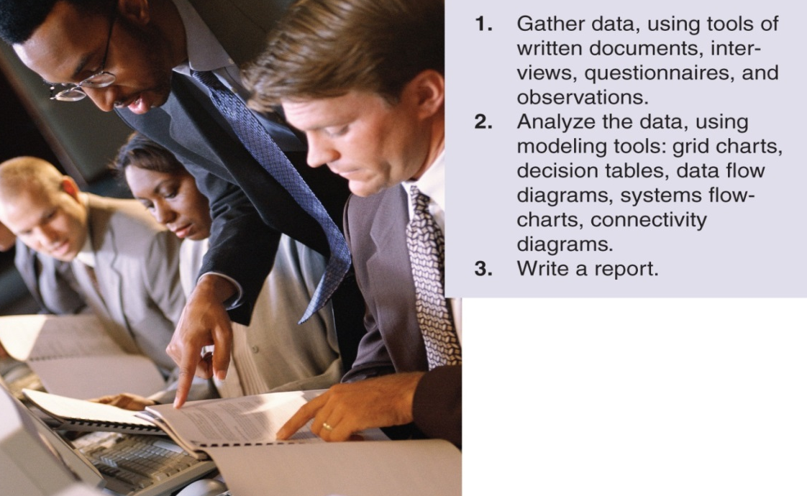
SDLC Phase 2: Analyze the System
Gather data
Interview employees and managers
Develop, distribute, analyze questionnaires
Review current written documents
Observe people and processes at work
Analyze the data
Use modeling tools, such as CASE tools
Create a data flow diagram to show how data flows through the system
Write a report
Document how the current system works
Document problems with the current system
Describe the requirements for the new system
Recommend what to do next and get management approval to proceed

Slide 11
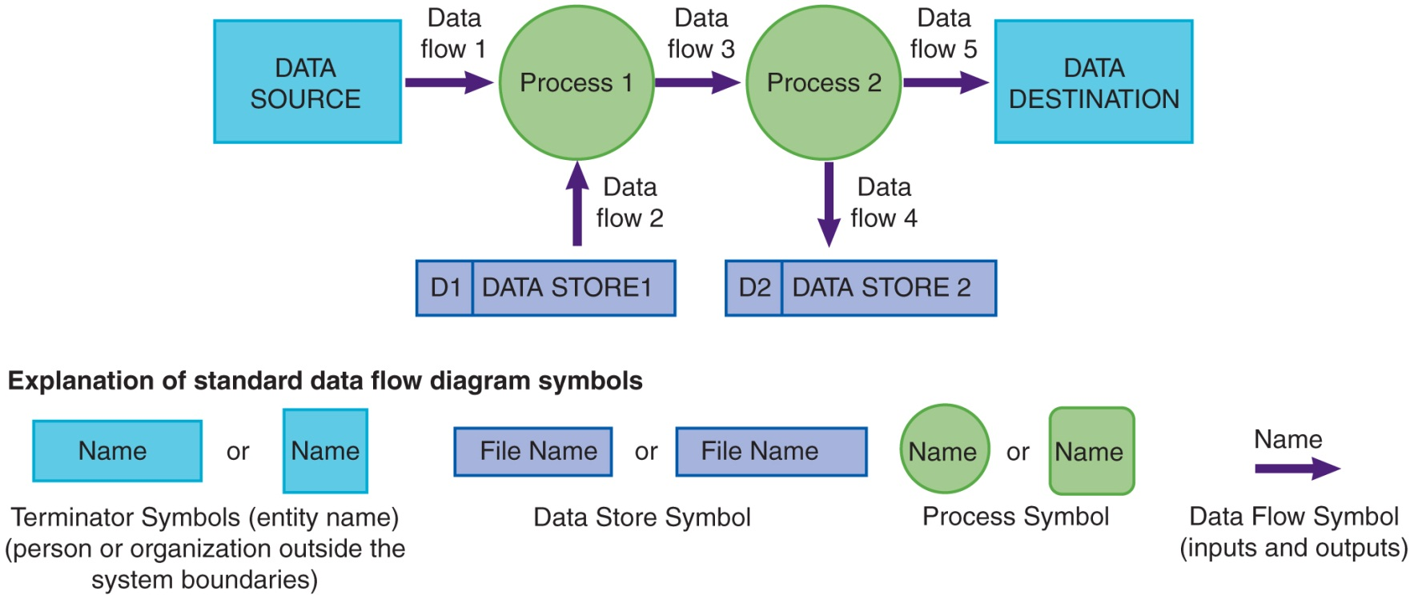
Data Flow Diagram Example

Slide 12
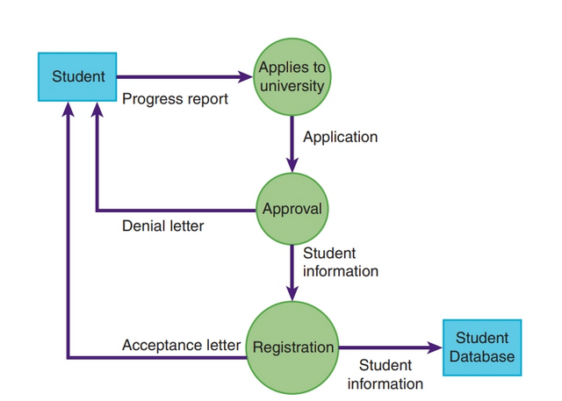

Slide 13
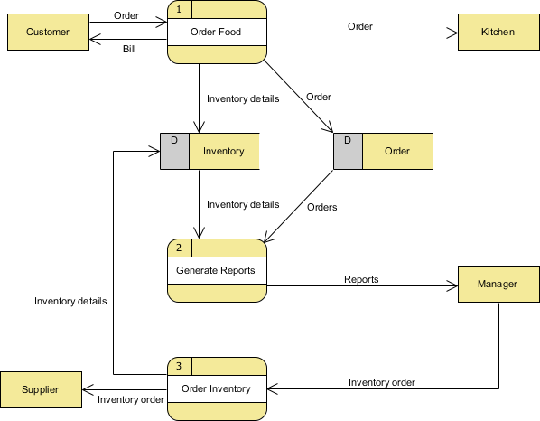

Slide 14
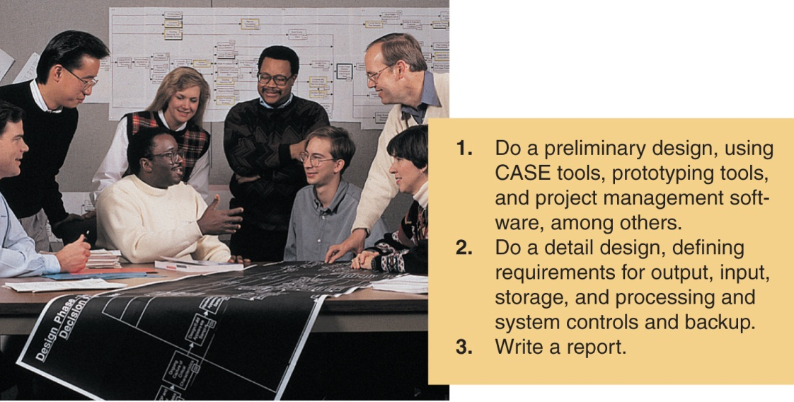
SDLC Phase 3: Design the System
Do a preliminary design
Often involves prototyping and continued use of CASE tools
Do a detail design, showing:
Output requirements
Input requirements
Storage requirements
Processing requirements
System controls
Backup
Write a report and get approval for next phase

Slide 15
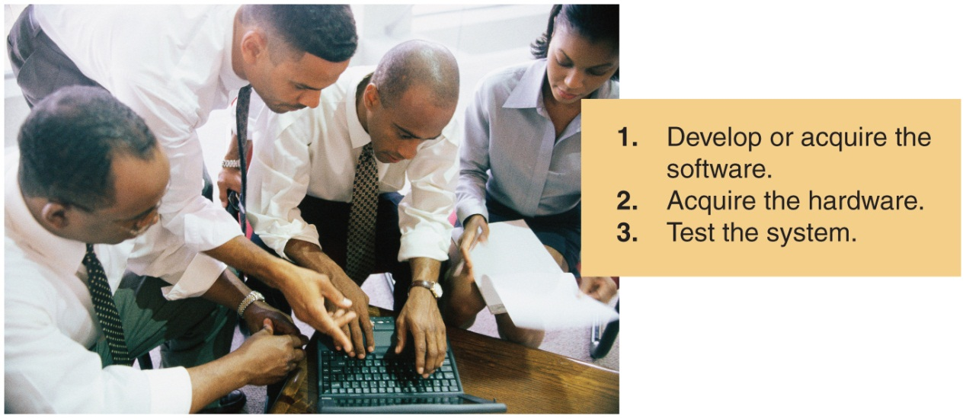
SDLC Phase 4: Develop the System
Develop or acquire the software
Make-or-buy decision
If creating own system, programming (coding must be done)
Acquire or upgrade the hardware
Test the system
Unit testing: performance of system’s individual parts tested
System testing: parts are linked and tested to see if they work together properly; real data may be used

Slide 16
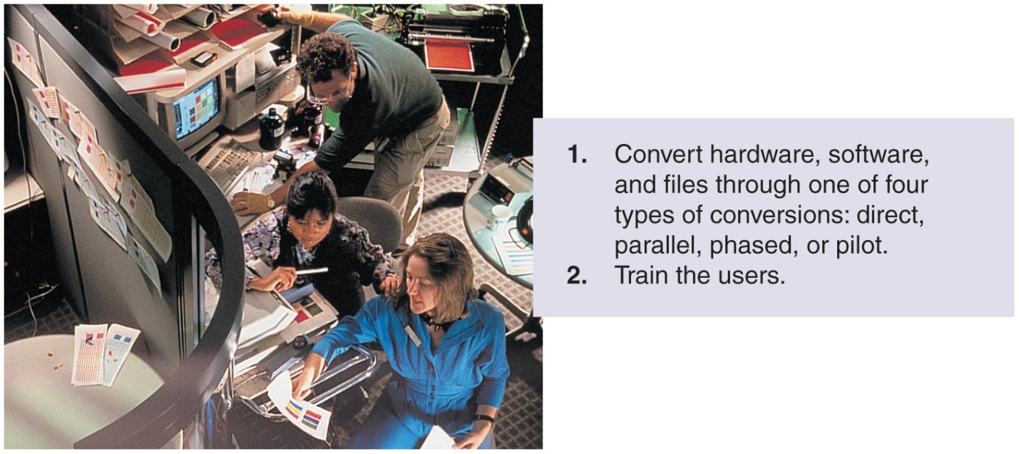
SDLC Phase 5: Implement the System
Choose a strategy to convert to the new system
Direct implementation: quit the old and start using the new
Parallel implementation: use both the old and the new side by side, until the new system has been proved reliable
Phased implementation: phase in parts of new in gradually as parts of old are phased out
Pilot implementation: have the new system tried out by a few users
Train the users

Slide 17

SDLC Phase 6: Maintain & Update the System
Perform system audits and periodic evaluations
Make changes to the system based on new conditions
Finalize documentation
Note that documentation should have been continuously maintained during the entire SDLC

Slide 18
Computer Aided Software Engineering(CASE)
Development and maintenance of software projects with help of various automated software tools.
There are number of CASE tools available to simplify various stages of Software Development Life Cycle such as Analysis tools, Design tools, Project management tools, Database Management tools, Documentation tools are to name a few.
Use of CASE tools accelerates the development of project to produce desired result and helps to uncover flaws before moving ahead with next stage in software development.

Slide 19
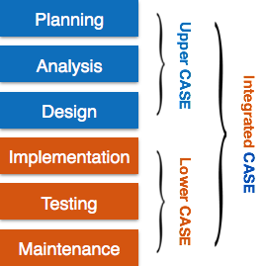
CASE continued………
CASE tools can be broadly divided into the following parts based on their use at a particular SDLC stage:
Central Repository - CASE tools require a central repository, which can serve as a source of common, integrated and consistent information. Central repository is a central place of storage where product specifications, requirement documents, related reports and diagrams, other useful information regarding management is stored. Central repository also serves as data dictionary.
Upper Case Tools - Upper CASE tools are used in planning, analysis and design stages of SDLC.
Lower Case Tools - Lower CASE tools are used in implementation, testing and maintenance.
Integrated Case Tools - Integrated CASE tools are helpful in all the stages of SDLC, from Requirement gathering to Testing and documentation.

Slide 20

UNIT 10B: Programming Languages
One of the first requirements for being a software developer or engineer is to learn not just the steps in programming but also programming languages.

Slide 21
10.2 Programming
Traditionally a Five-Step Procedure

Slide 22
A program is a list of instructions that the computer must follow to process data into information.
Programming is done during phase 4 of the SDLC.
The five steps:
Clarify/define the problem
Design a solution
Code the program
Test the program
Document and maintain the program

Slide 23
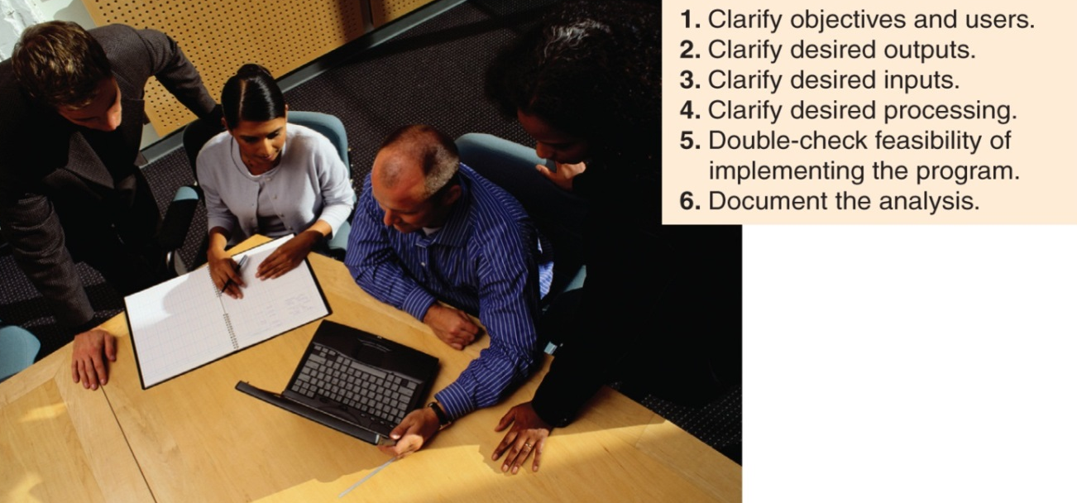
Programming Step 1: Clarify the Programming Needs
Clarify objectives & users
Clarify desired outputs
Clarify desired inputs
Clarify the desired processing
Double-check the feasibility of implementing the program
Document the analysis

Slide 24
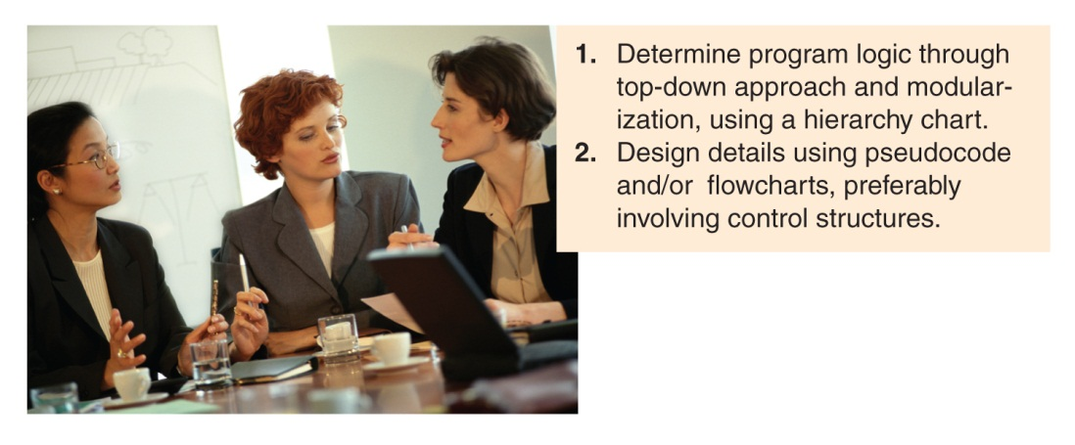
Programming Step 2: Design the Program
Create an algorithm, or set of clear steps, to solve the problem
Determine program logic using top-down approach and modules, using a hierarchy chart (graphic form), pseudocode (narrative form), and flowcharts that use control structures

Slide 25


The taxi algorithm:
Go to the taxi stand.
Get in a taxi.
Give the driver my address.
The call-me algorithm:
When your plane arrives, call my cellphone.
Meet me outside baggage claim.
The rent-a-car algorithm:
Take the shuttle to the rental car place.
Rent a car.
Follow the directions to get to my house.
The bus algorithm:
Outside baggage claim, catch bus number 70.
Transfer to bus 14 on Main Street.
Get off on Elm street.
Walk two blocks north to my house.
ALGORITHM EXAMPLES
www.ask.com

Slide 26
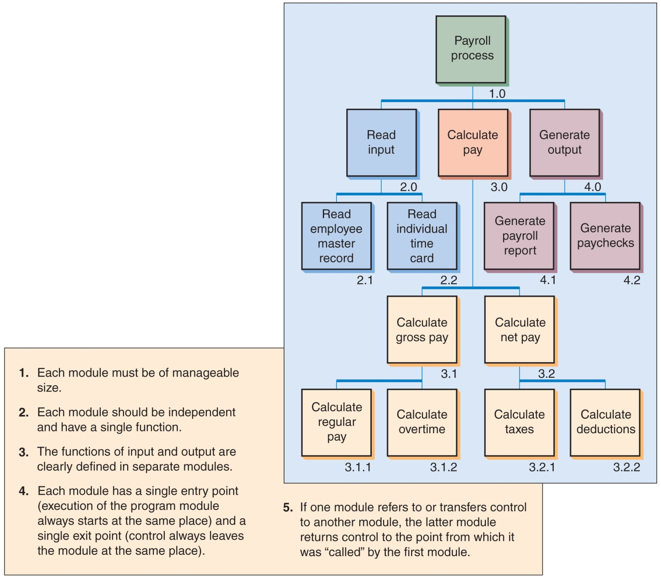
Hierarchy Chart

Slide 27
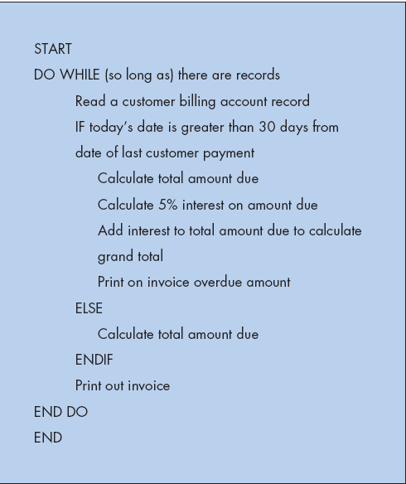
Pseudocode

Slide 28
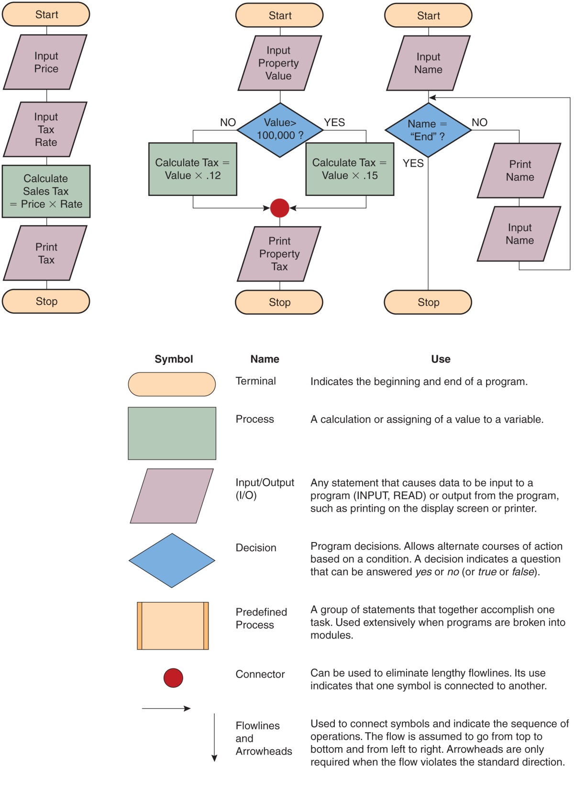

Program Flowchart & Symbols

Slide 29
Step 2: Design the Program (continued)
Structured programming
Use control structures (logic structures), structures that control the logical sequence in which computer program instructions are executed.
In structured program design, three control structures are used to form the logic of a program: sequence, selection, and iteration (or loop).
Sequence: one statement follows another in logical order
Selection: IF-THEN-ELSE
Iteration (loop): DO UNTIL / DO WHILE

Slide 30
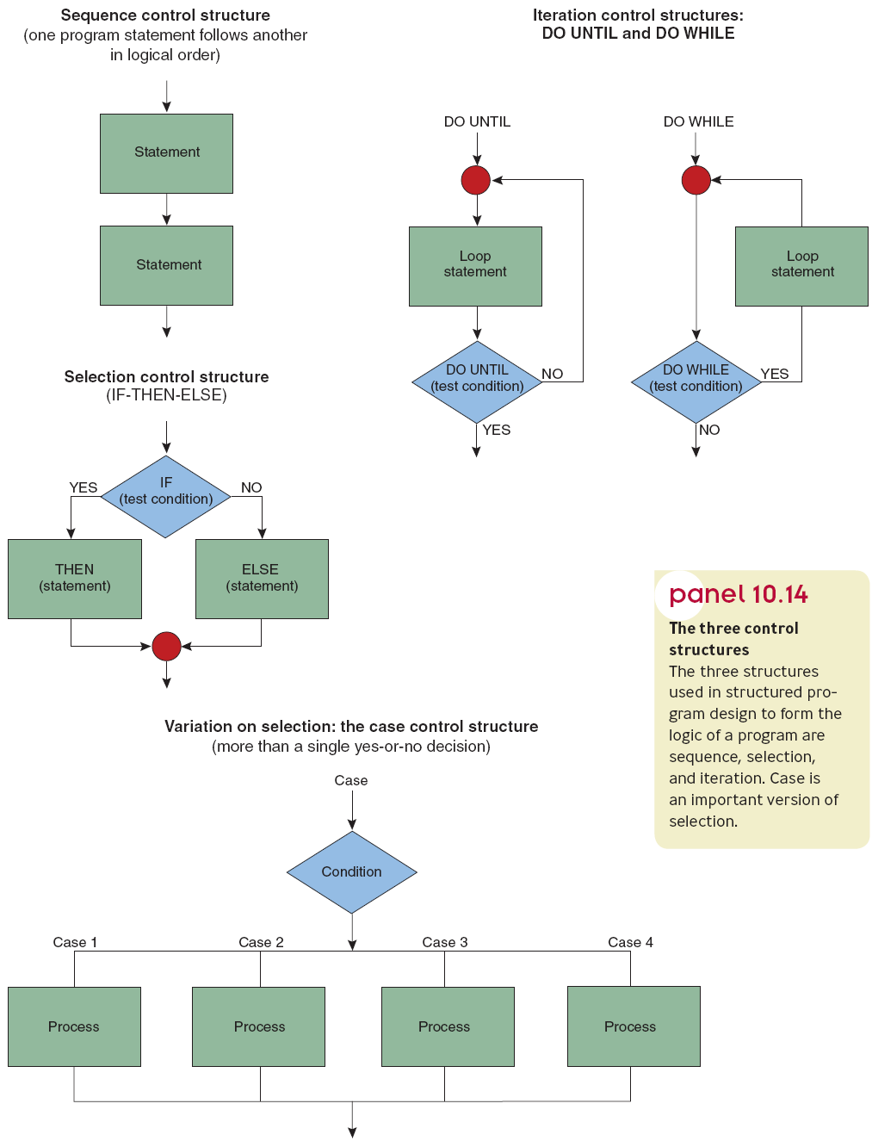
1
3
Three Control Structures
2

Slide 31

Programming Step 3: Code the Program
Coding: Translating the logic requirement from flowcharts and pseudocode into a programming language
Select a programming language (set of rules that tells the computer what operations to do)
Each programming language has a syntax, or set of grammatical rules to follow to write valid expressions
Syntax rules must be followed or there will be syntax errors
Computers don’t understand what you want, only what you type in

Slide 32

Programming Step 4: Test the Program
Desk checking is reading through, or checking, the program for syntax errors and logic errors
Debugging is the process of detecting, locating, and removing all syntax errors and logic errors in a computer program
Beta testing is the process of testing the program using real data
One phase of testing uses correct data
Once the program works, the next phase of testing uses invalid data and untrained users to root out hidden errors

Slide 33

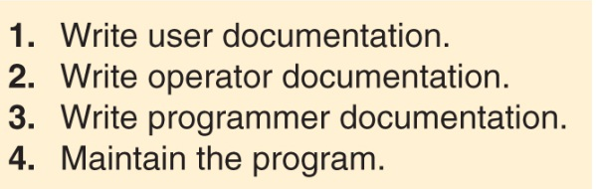
Programming Step 5: Document and Maintain the Program
Documentation is written descriptions of what a program is and how to fix it; should be done through all 5 steps
User documentation – for the people who will use the program (e.g., user manual – hardcopy or CD, and online)
Operator documentation – for the computer operators, so they know what to do if the program or hardware malfunctions
Programmer documentation – for the next programmer who must modify and maintain what has been written
Maintain the program – keep everything in working condition

Slide 34
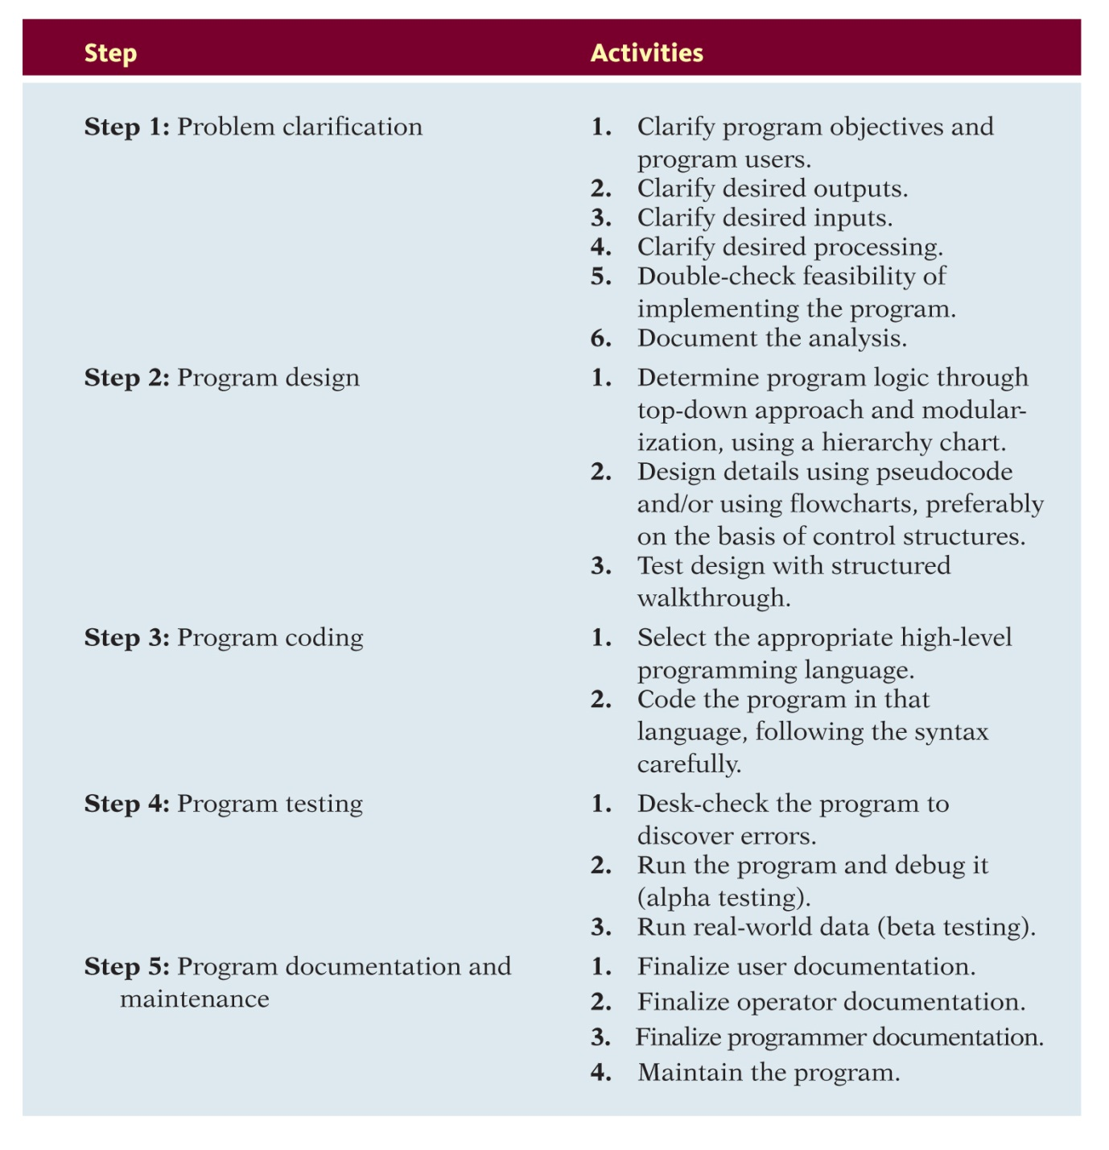
Summary of Programming Steps

Slide 35
Introduction to Python

